Slide 1
1. Http1.1 vs Http2
Difference

Slide 2
http1.1and http2 Advancesment
HTTP/1 was known to have poor response time. With websites becoming more resource-intensive, the protocol was losing its efficiency. It progressively became essential to minimize latency and boost page load speeds.
Google looked into these problems. And as expected, SPDY - an experimental project to end troubles with HTTP/1.x – was put into trial in the year 2010.
HTTP/2, based on SPDY protocol, was developed to address the inherent limitations of HTTP/1.1 and further progress the Internet.

Slide 3
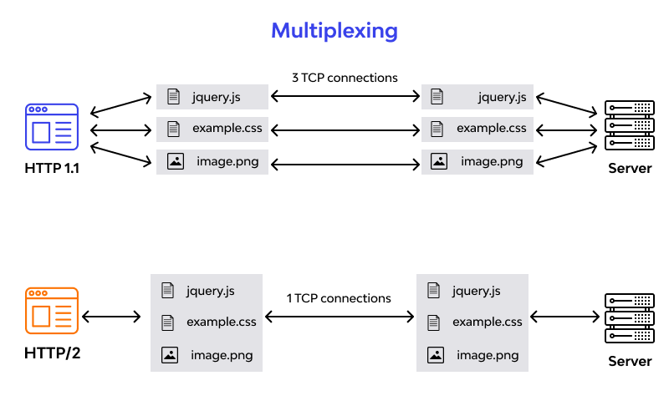
http1.1 and http2

Slide 4
Main difference between http1.1vs http2
HTTP/1.1 | HTTP/2
It works on the textual format. | It works on the binary protocol.
There is head of line blocking that blocks all the requests behind it until it doesn’t get its all resources. | It allows multiplexing so one TCP connection is required for multiple requests.
It uses requests resource Inlining for use getting multiple pages | It uses PUSH frame by server that collects all multiple pages
It compresses data by itself. | It uses HPACK for data compression.

Slide 5
2. Object Life Cycle
Objects are created, used, and discarded
Constructors are implicit in JavaScript - natural
A constructor in a class is a special block of statements called when an object is created
Destructors are not provided by JavaScript

Slide 6
Object Instances in JS
We can create lots of objects - the class is the template for the object.
We can store each distinct object in its own variable.
We call this having multiple instances of the same class.
Each instance has its own copy of the instance variables.

Slide 7
Example for object
var car1 = ["white", "fibre", 4, "petrol", 20];
var car2 = ["black", "plastic", 4, "disel", 30];
Object {}-symbal
var car = {
key value
| |
color: "white",
material: "fibre",
wheels: 4,
milege: 20
}

Slide 8
Thank you..

